Slide 1






PROJECT 1 EMPLOYEE DATA ANALYSIS

Slide 2
Create a pivot table to summarize the total number of employees in each department
Department | Admin Offices | Executive Office | IT/IS | Production | Sales | Software Engineering | Grand Total
Count of Employees | 80 | 24 | 430 | 2020 | 331 | 115 | 3000

Slide 3
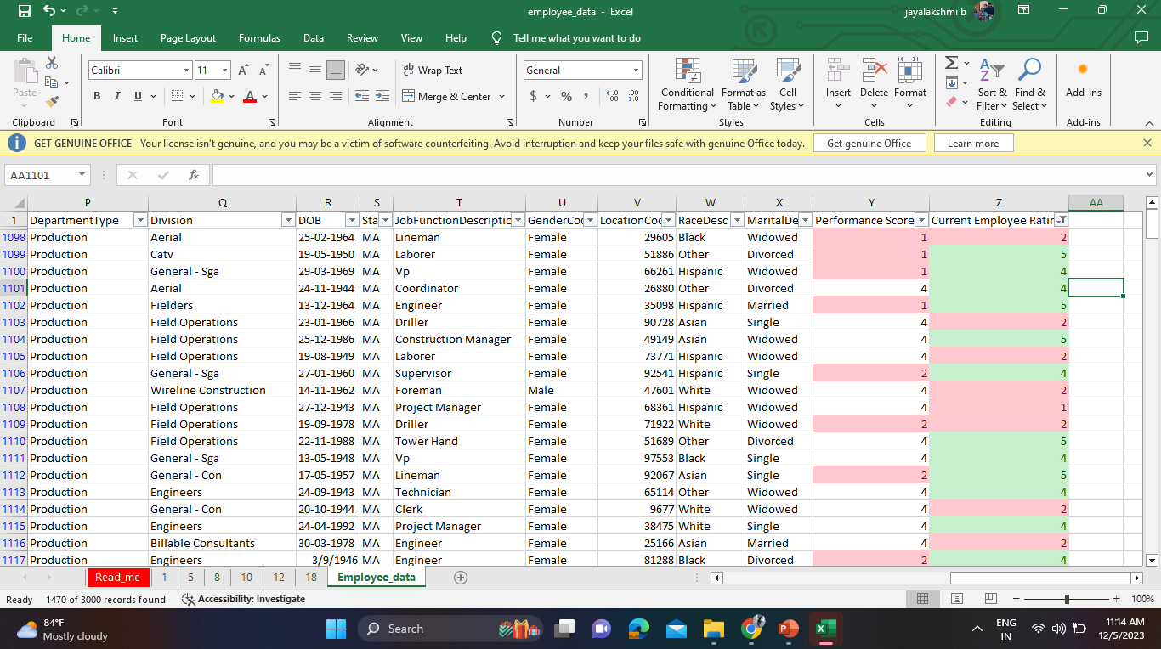
Apply conditional formatting to highlight employees with a "Performance Score" below 3 in red

Slide 4
Calculate the average "Satisfaction Score" for male and female employees separately using a pivot table
GENDER | Female | Male | Grand Total
Average of Satisfaction Score | 3.006 | 3.042 | 3.022

Slide 5
Create a chart to visualize the distribution of "Work-Life Balance Score" for different job functions

Slide 6
Filter the data to display only terminated employees and find out the most common "Termination Type."
Termination Type | Involuntary | Resignation | Retirement | Unk | Voluntary | Grand Total
Count of EmployeeStatus | 388 | 380 | 377 | 1467 | 388 | 3000

Slide 7
Calculate the average "Engagement Score" for each department using a pivot table
Department | Admin Offices | Executive Office | IT/IS | Production | Sales | Software Engineering | Grand Total
Average of Engagement Score | 2.925 | 3.375 | 3.026 | 2.906 | 2.991 | 2.974 | 2.940

Slide 8
Use VLOOKUP to find the supervisor's email address for a specific employee
VLOOKUP(D2,A:C,3,FALSE)
Employee ID | First Name | Email
1014 | Heidi | brentswanson@example.org
1020 | Cheryl | corey49@example.net
1027 | Cory | sandraferrell@example.net
1060 | Susan | zmoore@example.com

Slide 9
Can you identify the department with the highest average "Employee Rating?"
Department | Admin Offices | Executive Office | IT/IS | Production | Sales | Software Engineering | Grand Total
Average of Current Employee Rating | 3.025 | 2.792 | 2.970 | 2.982 | 2.909 | 2.904 | 2.969

Slide 10
Create a scatter plot to explore the relationship between "Training Duration (Days)" and "Training Cost."

Slide 11
Build a pivot table that shows the count of employees by "RaceDesc" and "GenderCode."
Count of Employees | RaceDesc
GenderCode | Asian | Black | Hispanic | Other | White | Grand Total
Female | 346 | 346 | 325 | 318 | 347 | 1682
Male | 283 | 272 | 247 | 264 | 252 | 1318
Grand Total | 629 | 618 | 572 | 582 | 599 | 3000

Slide 12
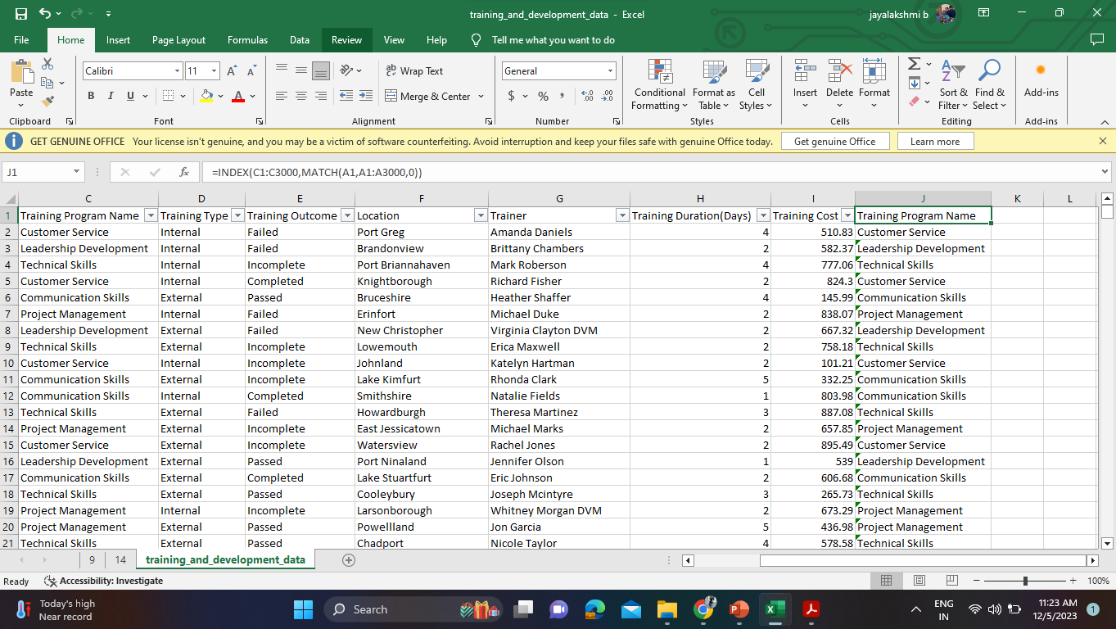
Use INDEX and MATCH functions to find the "Training Program Name" for an employee with a specific ID

Slide 13
Create a multi-level pivot table to analyze the "Performance Score" by "BusinessUnit" and "JobFunctionDescription."
Count of JobFunctionDescription | BusinessUnit
Performance Score | BPC | CCDR | EW | MSC | NEL | PL | PYZ | SVG | TNS | WBL | Grand Total
Exceeds | 36 | 39 | 39 | 39 | 30 | 34 | 35 | 46 | 41 | 30 | 369
Fully Meets | 235 | 234 | 240 | 226 | 251 | 241 | 228 | 233 | 233 | 240 | 2361
Needs Improvement | 24 | 17 | 16 | 20 | 11 | 16 | 23 | 20 | 15 | 15 | 177
PIP | 8 | 10 | 7 | 11 | 12 | 10 | 13 | 5 | 8 | 9 | 93
Grand Total | 303 | 300 | 302 | 296 | 304 | 301 | 299 | 304 | 297 | 294 | 3000

Slide 14
Calculate the total training cost for each "Training Program Name" and display it in a bar chart
Training Program Name | Communication Skills | Customer Service | Leadership Development | Project Management | Technical Skills | Grand Total
Sum of Training Cost | 365023.24 | 320575.04 | 323902.03 | 343313.17 | 323072.61 | 1675886.09

Slide 15
Apply advanced conditional formatting to highlight the top 10% and bottom 10% of employees based on "Current Employee Rating."

Slide 16
Use a calculated field in a pivot table to determine the average "Engagement Score" per year
Average of Engagement Score | 2022 | 2023 | Grand Total
Qtr1 |  | 2.902 | 2.902
Qtr2 |  | 3.014 | 3.014
Qtr3 | 2.963 | 2.940 | 2.954
Qtr4 | 2.892 |  | 2.892
Grand Total | 2.918 | 2.954 | 2.940

Slide 17
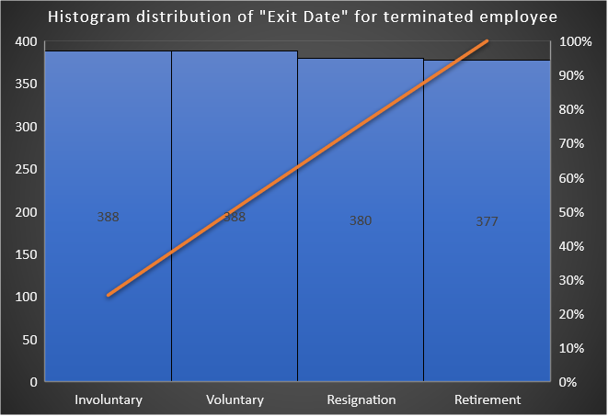
Create a histogram to understand the distribution of "ExitDate" for terminated employees
TerminationType | Count of ExitDate
Involuntary | 388
Resignation | 380
Retirement | 377
Voluntary | 388

Slide 18
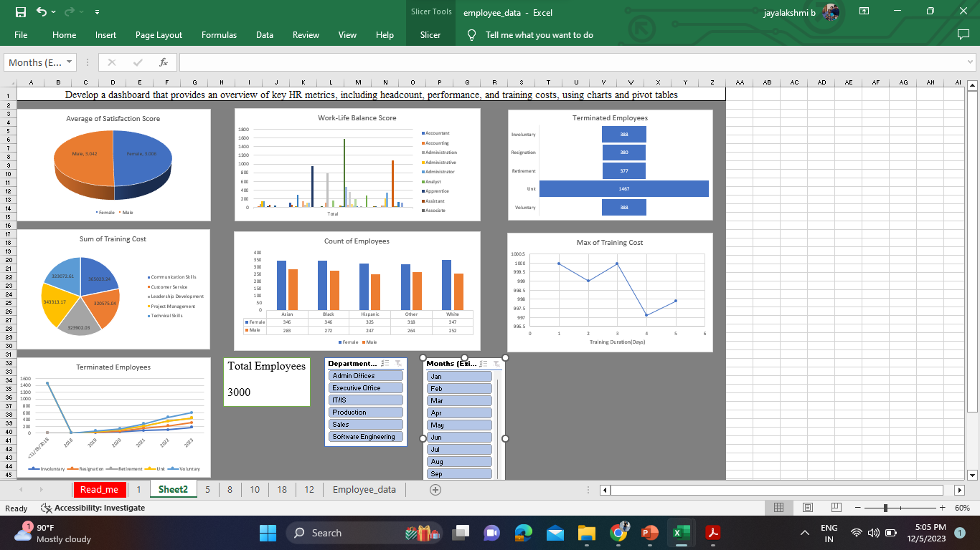
Develop a dashboard that provides an overview of key HR metrics, including headcount, performance, and training costs, using charts and pivot tables

